Slide 1
CS 5402 Introduction to Data Mining
k Nearest Neighbor
v.1
Perry B. Koob, koobp@mst.edu

Slide 2
What we are going to learn.
Instance-Based Learning
k Nearest Neighbor (kNN)
kD-tree

Slide 3
Instance-Based Learning
Instance-Based Learning is a Supervised Learning technique.
The inputs are Interval or Ratio.
Inputs can be Nominal; for that case we calculate the distance differently.
Normalize all Interval or Ratio inputs.
The Class is Nominal.

Slide 4
Instance-Based Learning
All training examples are stored.
When a new entry is evaluated we calculate the distance between all the examples and the new entry.
We then determine the Classes of the k nearest examples and assign the new entry to the Class that the most neighbors are in.

Slide 5
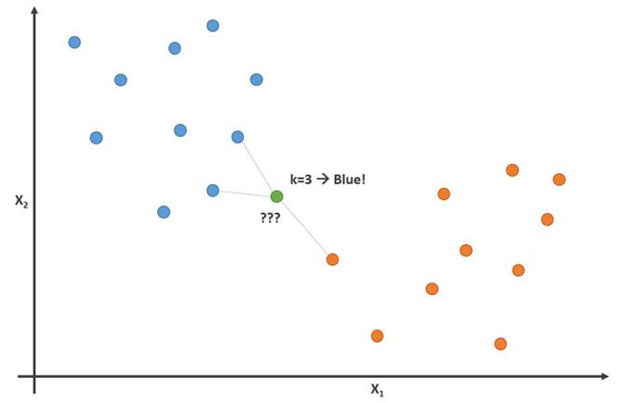
k Nearest Neighbor
https://www.kdnuggets.com/2017/09/rapidminer-k-nearest-neighbors-laziest-machine-learning-technique.html

Slide 6
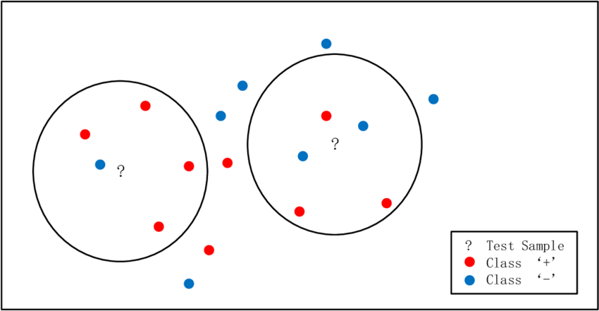
k Nearest Neighbor
https://www.researchgate.net/figure/An-example-of-kNN-classification-task-with-k-5_fig1_293487460

Slide 7
k Nearest Neighbor
No assumptions about the relationship between your predictors and your class.
Really easy to set up.
Can be time consuming because the number of calculations
Called a “lazy learner” because the distance calculations are performed at classification time and not ahead of time. No training time upfront.

Slide 8
k Nearest Neighbor
You can pick your distance function and you can pick your k.
If the attributes are Nominal, then we calculate the distance between them with a binary function...
If the labels are the same, then the distance = 0.
If the labels are different, then the distance = 1.
If the attributes are Interval and Ratio, then there are many distance functions to choose from.

Slide 9
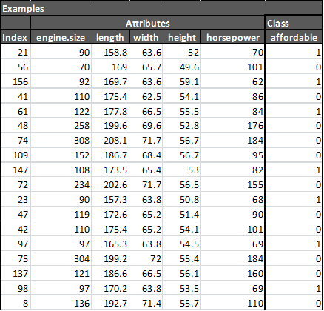
k Nearest Neighbor
for each attribute X
x_{i} = ( x_{i} - min(X) )
(max(X) - min(X))
X = attribute
x_{i} = an individual value of X

Slide 10
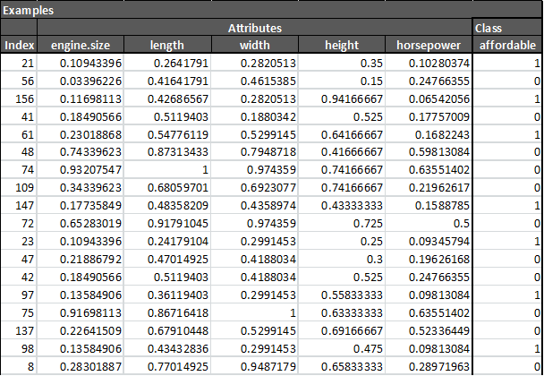
k Nearest Neighbor
for each attribute X
x_{i} = ( x_{i} - min(X) )
(max(X) - min(X))
X = attribute
x_{i} = an individual value of X

Slide 11
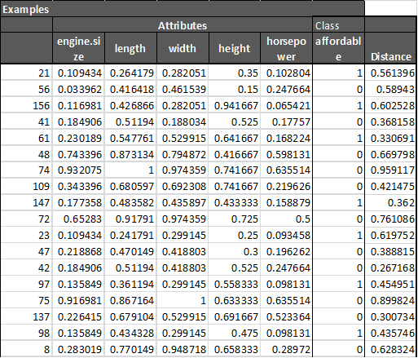
k Nearest Neighbor
Calculate the Distance
Distance = (|X^{A}₁- X^{B}₁ |² + |X^{A}₂- X^{B}₂ |² + … + |X^{A}_{n}- X^{B}_{n} |²)^{1/2}

Slide 12
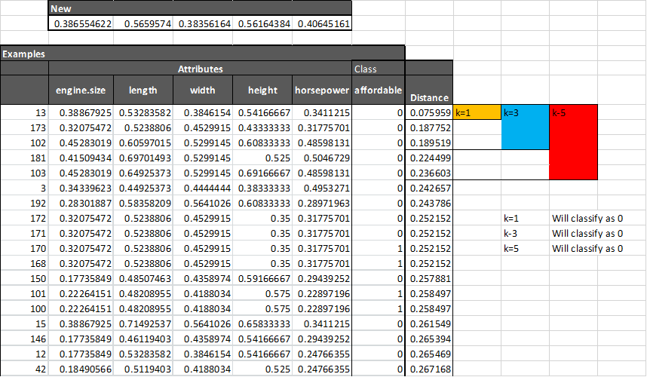
k Nearest Neighbor

Slide 13
k Nearest Neighbor
Minkowski Distance
d_{m}(x^{A}, x^{B}) = (|X^{A}₁- X^{B}₁ |^{p} + |X^{A}₂- X^{B}₂ |^{p} + … + |X^{A}_{n}- X^{B}_{n} |^{p})^{1/p}
Manhattan Distance (p = 1)
d_{manhattan}(x^{A}, x^{B}) = (|X^{A}₁- X^{B}₁ | + |X^{A}₂- X^{B}₂ | + … + |X^{A}_{n}- X^{B}_{n} |)
Euclidean Distance (p = 2)
d_{euclidian}(x^{A}, x^{B}) = (|X^{A}₁- X^{B}₁ |² + |X^{A}₂- X^{B}₂ |² + … + |X^{A}_{n}- X^{B}_{n} |²)^{1/2}
Cosine distance...
We will go Euclidean Distance

Slide 14
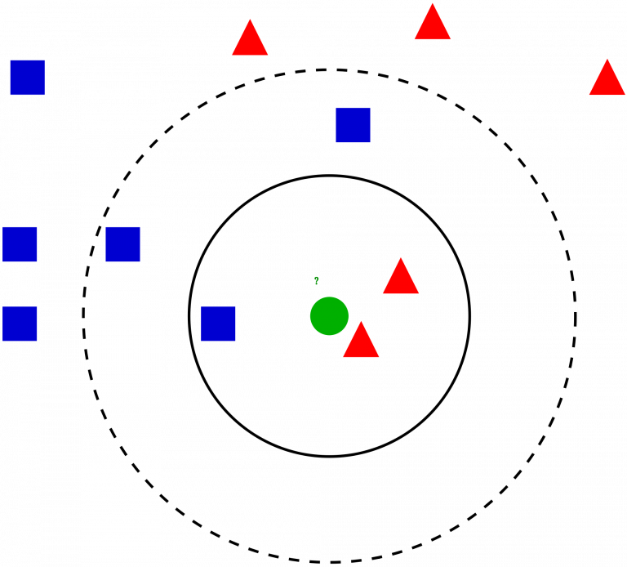
k Nearest Neighbor
You can pick your distance function and you can pick your k.
The larger the k the less resolution, or distinct
your classification boundaries are.
https://www.analyticsvidhya.com/blog/2018/03/introduction-k-neighbours-algorithm-clustering/

Slide 15
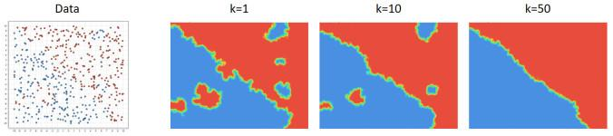
k Nearest Neighbor
You can pick your distance function and you can pick your k.
The larger the k the less resolution, or boundary discrimination, you have.
https://www.kdnuggets.com/2017/09/rapidminer-k-nearest-neighbors-laziest-machine-learning-technique.html

Slide 16
k Nearest Neighbor - R
# Import data
data <- read.csv(file = '../src-data/imports-85.csv',stringsAsFactors=TRUE)
# Remove examples with missing values
data <- data[data['price'] != '?',]
data <- data[data['horsepower'] != '?',]
#Convert factor to numeric
data$horsepower <- as.numeric(as.character(data$horsepower))
data$price <- as.numeric(as.character(data$price))
# Create class
data$affordable[data$price < 10000] <- 1
data$affordable[data$price >= 10000] <- 0

Slide 17
k Nearest Neighbor - R
# Function to normalize
normalize <- function(x) {
return ((x - min(x)) / (max(x) - min(x)))
}
data <- data[,c('engine.size','length','width','height','horsepower','affordable')]
data$engine.size <- normalize(data$engine.size)
data$length <- normalize(data$length)
data$width <- normalize(data$width)
data$height <- normalize(data$height)
data$horsepower <- normalize(data$horsepower)

Slide 18
k Nearest Neighbor - R
# Partition data into train and test with 75/25 split
set.seed(314)
sample_size <- floor(0.75 * nrow(data))
training_index <- sample(seq_len(nrow(data)), size = sample_size)
train <- data[training_index, ]
test <- data[-training_index, ]

Slide 19
k Nearest Neighbor - R
library(class)
x_train <- train[,c('engine.size','length','width','height','horsepower')]
x_test <- test[,c('engine.size','length','width','height','horsepower')]
y_train <- train[,c('affordable')]
knn_model <- knn(x_train, x_test, y_train, k =5, l=3, prob=FALSE)
summary(knn_model)
0 1
22 28

Slide 20
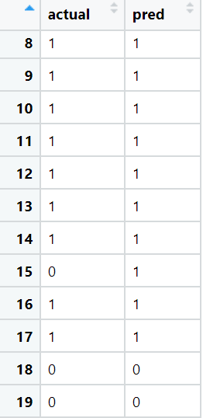
k Nearest Neighbor - R
prediction = as.data.frame(test[,"affordable"])
colnames(prediction)<-"actual"
j = 0
for (i in rownames(x_test)){
j = j+1
results <- knn(x_train, x_test[i,], y_train, k =5)
prediction[j,"pred"] <- results
}
prediction

Slide 21
k Nearest Neighbor - Python
# Import modules
import pandas as pd
from sklearn.neighbors import KNeighborsClassifier
from sklearn.model_selection import train_test_split
from sklearn.metrics import confusion_matrix
# Import data
data = pd.read_csv("..\\src-data\\imports-85.csv")
# Remove examples with missing anc convert price to float
data = data[data['price'] != '?']
data = data[data['horsepower'] != '?']
data['price'] = data['price'].astype(float)

Slide 22
k Nearest Neighbor - Python
# Create a class
data['affordable'] = 0
data.loc[(data['price'] < 10000), 'affordable'] = 1
# Divide up the X and Y attributes
X = data[['engine-size','length','width','height']].astype(float)
Y = data[['affordable']].astype(int)
# Partition the data into a 0.75 and 0.25 split
X_train, X_test, Y_train, Y_test = train_test_split(X, Y, train_size = 0.75)

Slide 23
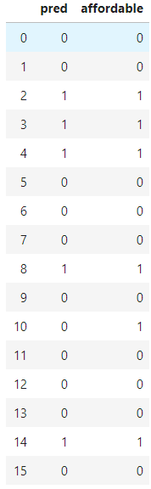
k Nearest Neighbor - Python
model = KNeighborsClassifier(n_neighbors=3)
model.fit(X_train, Y_train['affordable'])
y_pred = model.predict(X_test)
pred = pd.DataFrame(y_pred, )
pred.rename(columns = {0:"pred"}, inplace = True)
results = pd.concat([pred, Y_test.reset_index(drop=True)], axis=1)

Slide 24
k Nearest Neighbor
To evaluate the model we can use the Confusion Matrix.
confusionMatrix(as.factor(prediction$pred),as.factor(prediction$actual))
confusion_matrix(results['affordable'], results['pred'])

Slide 25
k Nearest Neighbor - Applications
Chen, H. L., Huang, C. C., Yu, X. G., Xu, X., Sun, X., Wang, G., & Wang, S. J. (2013). An efficient diagnosis system for detection of Parkinson’s disease using fuzzy k-nearest neighbor approach. Expert systems with applications, 40(1), 263-271.
Chen, Y., & Hao, Y. (2017). A feature weighted support vector machine and K-nearest neighbor algorithm for stock market indices prediction. Expert Systems with Applications, 80, 340-355.
Chirici, G., Mura, M., McInerney, D., Py, N., Tomppo, E. O., Waser, L. T., ... & McRoberts, R. E. (2016). A meta-analysis and review of the literature on the k-Nearest Neighbors technique for forestry applications that use remotely sensed data. Remote Sensing of Environment, 176, 282-294.
Deekshatulu, B. L., & Chandra, P. (2013). Classification of heart disease using k-nearest neighbor and genetic algorithm. Procedia Technology, 10, 85-94.
Frigyesi, A., Veerla, S., Lindgren, D., & Höglund, M. (2006). Independent component analysis reveals new and biologically significant structures in micro array data. BMC bioinformatics, 7(1), 290.

Slide 26
k Nearest Neighbor - Applications
Govindarajan, M., & Chandrasekaran, R. M. (2010). Evaluation of k-nearest neighbor classifier performance for direct marketing. Expert Systems with Applications, 37(1), 253-258.
Imandoust, S. B., & Bolandraftar, M. (2013). Application of k-nearest neighbor (knn) approach for predicting economic events: Theoretical background. International Journal of Engineering Research and Applications, 3(5), 605-610.
Indriati, I., & Ridok, A. (2016). Sentiment Analysis For Review Mobile Applications Using Neighbor Method Weighted K-Nearest Neighbor (Nwknn). Journal of Environmental Engineering and Sustainable Technology, 3(1), 23-32.
Kaghyan, S., & Sarukhanyan, H. (2012). Activity recognition using k-nearest neighbor algorithm on smartphone with tri-axial accelerometer. International Journal of Informatics Models and Analysis (IJIMA), ITHEA International Scientific Society, Bulgaria, 1, 146-156.
Kirchner, M. (2010, May). A framework for detecting anomalies in http traffic using instance-based learning and k-nearest neighbor classification. In 2010 2nd International Workshop on Security and Communication Networks (IWSCN) (pp. 1-8). IEEE.

Slide 27
k Nearest Neighbor - Applications
Kirchner, M. (2010, May). A framework for detecting anomalies in http traffic using instance-based learning and k-nearest neighbor classification. In 2010 2nd International Workshop on Security and Communication Networks (IWSCN) (pp. 1-8). IEEE.
Kumar, M., Jindal, M. K., & Sharma, R. K. (2011, November). k-nearest neighbor based offline handwritten Gurmukhi character recognition. In 2011 International Conference on Image Information Processing (pp. 1-4). IEEE.
Liu, C. L., Lee, C. H., & Lin, P. M. (2010). A fall detection system using k-nearest neighbor classifier. Expert systems with applications, 37(10), 7174-7181.
McRoberts, R. E., Nelson, M. D., & Wendt, D. G. (2002). Stratified estimation of forest area using satellite imagery, inventory data, and the k-Nearest Neighbors technique. Remote Sensing of Environment, 82(2-3), 457-468.
Medjahed, S. A., Saadi, T. A., & Benyettou, A. (2013). Breast cancer diagnosis by using k-nearest neighbor with different distances and classification rules. International Journal of Computer Applications, 62(1).

Slide 28
k Nearest Neighbor - Applications
Rajagopalan, B., & Lall, U. (1999). A k‐nearest‐neighbor simulator for daily precipitation and other weather variables. Water resources research, 35(10), 3089-3101.
Sandvig, J. J., Mobasher, B., & Burke, R. (2007, October). Robustness of collaborative recommendation based on association rule mining. In Proceedings of the 2007 ACM conference on Recommender systems (pp. 105-112).
Sohail, A. S. M., & Bhattacharya, P. (2007, March). Classification of facial expressions using k-nearest neighbor classifier. In International Conference on Computer Vision/Computer Graphics Collaboration Techniques and Applications (pp. 555-566). Springer, Berlin, Heidelberg.
Su, M. Y. (2011). Real-time anomaly detection systems for Denial-of-Service attacks by weighted k-nearest-neighbor classifiers. Expert Systems with Applications, 38(4), 3492-3498.
Tan, S. (2005). Neighbor-weighted k-nearest neighbor for unbalanced text corpus. Expert Systems with Applications, 28(4), 667-671.
Zheng, K., Fung, P. C., & Zhou, X. (2010, June). K-nearest neighbor search for fuzzy objects. In Proceedings of the 2010 ACM SIGMOD International Conference on Management of data (pp. 699-710).

Slide 29
Improving k Nearest Neighbor with kD-tree
Biggest issue with k Nearest Neighbor is that each new data example requires the calculation of distance between it and each data example in the training set.

Slide 30
kD-tree
kD-Trees are k Dimensional Trees
We iterate through each dimension, dividing the Space into smaller Spaces. Each Space will be a node in a binary tree.
When we have iterated through all dimensions we loop through again unit each Space only has n number. We can set n.

Slide 31
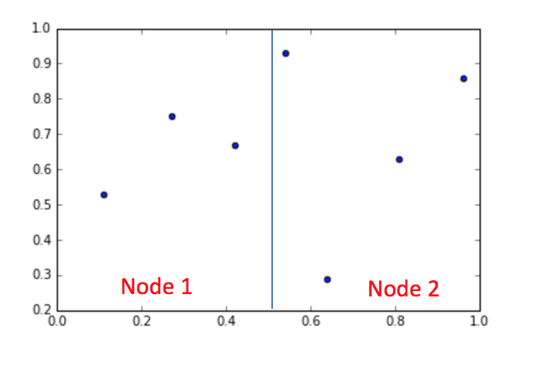
kD-tree
https://www.analyticsvidhya.com/blog/2017/11/information-retrieval-using-kdtree/

Slide 32
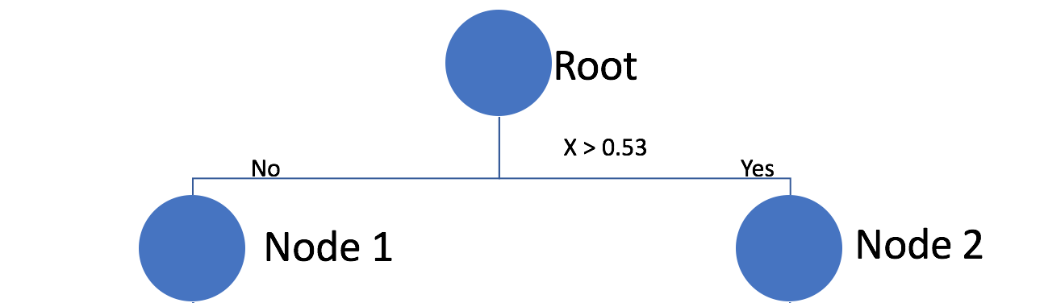
kD-tree
a = Max(X1) - Min(x1)
2
X₁ = a
X₁ = a
https://www.analyticsvidhya.com/blog/2017/11/information-retrieval-using-kdtree/

Slide 33
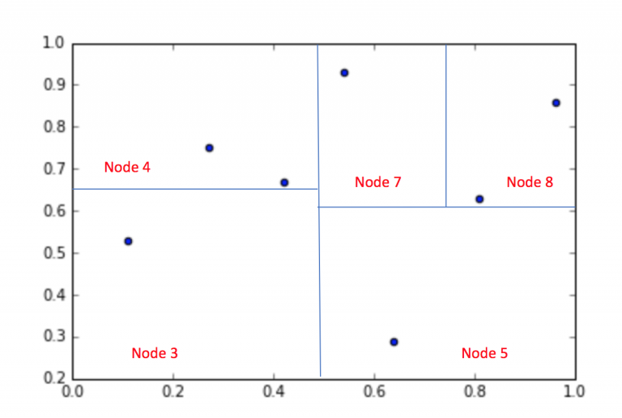
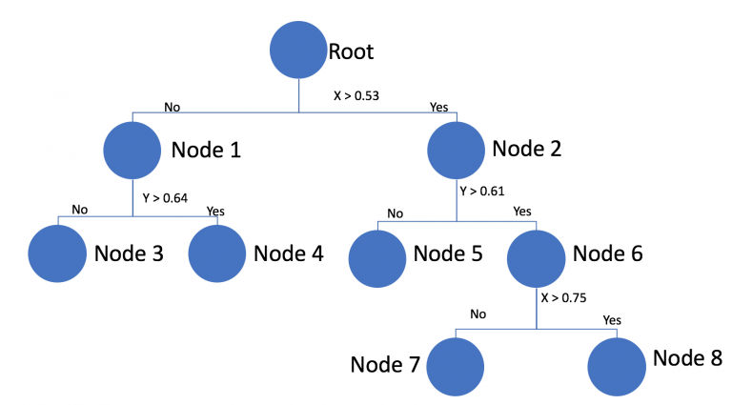
kD-tree
https://www.analyticsvidhya.com/blog/2017/11/information-retrieval-using-kdtree/

Slide 34
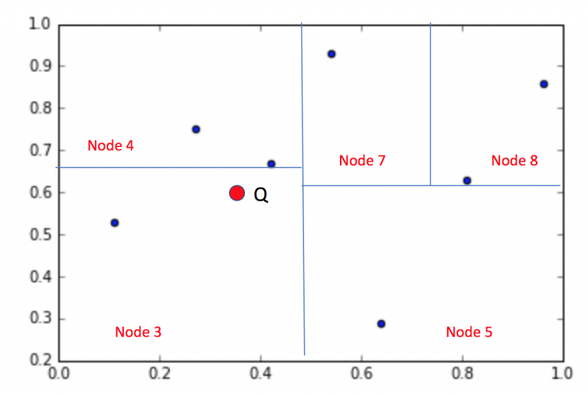
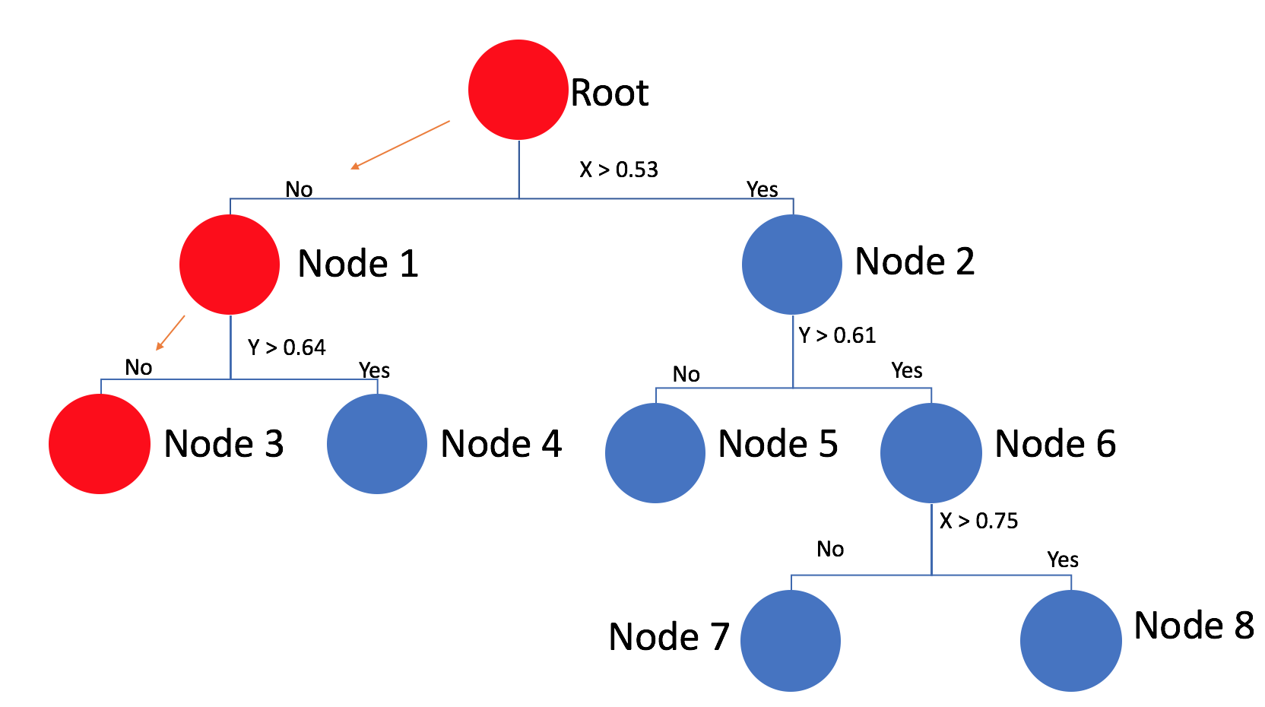
kD-tree
https://www.analyticsvidhya.com/blog/2017/11/information-retrieval-using-kdtree/

Slide 35
What we covered.
Instance-Based Learning
k Nearest Neighbor (kNN)
kD-tree

Slide 36
References
Hu, L. Y., Huang, M. W., Ke, S. W., & Tsai, C. F. (2016). The distance function effect on k-nearest neighbor classification for medical datasets. SpringerPlus, 5(1), 1304. https://doi.org/10.1186/s40064-016-2941-7
Shmueli, G., Bruce, P. C., Yahav, I., Patel, N. R., & Lichtendahl Jr, K. C. (2017). Data mining for business analytics: concepts, techniques, and applications in R. John Wiley & Sons.
Witten, I. H., Frank, E., Hall, M. A., & Pal, C. J. (2016). Data Mining: Practical Machine Learning Tools and Techniques.

